Slide 1


VETRI DQX – Intelligent Data Quality & Normalization Engine
AI-powered Data Validation using AIRLLM
This project focuses on solving real-world data quality problems using AI and layered validation.
- QUANTUM_CORE_GEN'X

Slide 2





Why Data Quality Matters: The Real-World Problem
Data is the Foundation
Specific Problems
Every system depends on data
Invalid Emails
Core input for analytics, AI, and decision systems
Fake or temporary email usage
Poor data quality breaks even the best algorithms
Incorrect Phones
Real-World Data is Messy
Wrong or dummy numbers
Enterprise data is rarely clean
User-entered data contains errors and typos
Duplicate Records
Redundant entries
Fake emails & temporary phone numbers are common
Inconsistent Fields
Missing or varied formats

Slide 3



The Challenge: Impact & Limitations
Business Impact of Poor Data Quality
1
Low Trust
Reduced confidence in systems.
2
Financial Loss
Direct monetary impact.
3
Poor Decisions
Based on flawed data.
4
Incorrect Reports
Misleading analysis.
Why Current Systems Fail
Rule-Based Only
Cloud Dependency
Not Scalable
Lacks semantic understanding
Limited offline capability
Struggles with large datasets
This is why VETRI DQX is essential – combining AI intelligence with offline capability and true scalability.

Slide 4

VETRI DQX Solution: Our Proposed Approach
Our Proposed Solution
Multi-Layer Validation
AI Normalization
Comprehensive data checks.
Intelligent data standardization.
Offline AIRLLM
Modular & Scalable
AI processing without cloud.
Flexible architecture.
Real-Time Processing
Semantic Understanding
Instant validation results.
Context-aware data analysis.

Slide 5





Technology Stack
Backend
Python and FastAPI for robust, scalable API development
AI Engine
AIRLLM with local LLM for intelligent processing
Models (mistral:latest,qwen2.5:7b-instruct-q4_K_M,phi3mini)
Data Base And Data Layer
Pandas for processing, PostgreSQL for storage
Frontend
ReactJS & TailwindCSS it provides a sleek, modern design that adapts seamlessly across all devices.

Slide 6












Our System : Key Modules
Six core components working together for comprehensive data quality
Email Validation
Phone Validation
Detect Invalid or Missing Fields
Duplicate Detection
Quality Assurance
Job Title Normalization

Slide 7





System Architecture
Raw Data
Ingestion from multiple sources
Validation Layer
Initial data quality checks
AIRLLM Intelligence
Semantic processing and normalization
Standardization Engine
Apply business rules and formatting
Clean Data Output
High-quality, consistent results

Slide 8
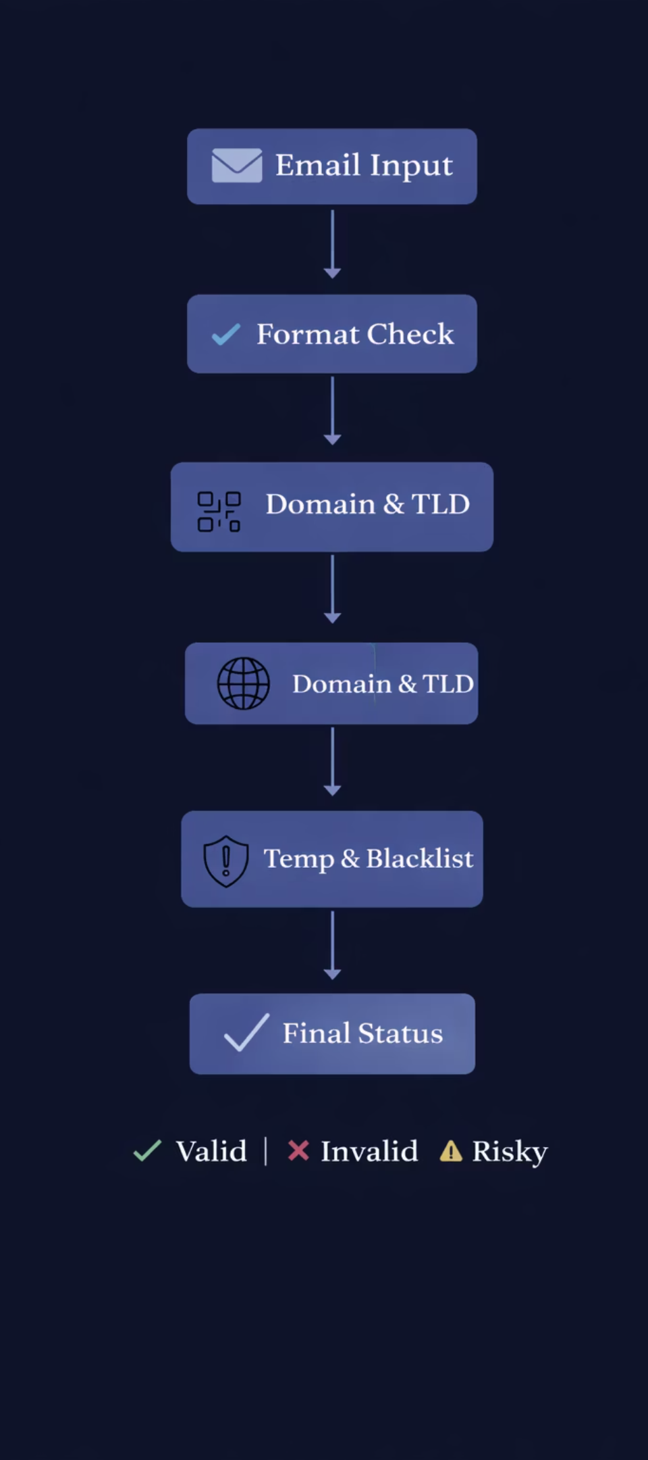
Email Verification – Multi-Layer Flow
Layer 1: Structural Validation
Regex format check
Domain syntax check
Valid TLD verification
Layer 2: Intelligence Validation
Boolean indexing for domain filtering
Allow trusted providers (Gmail, Yahoo, Outlook, etc.)
Block temporary / throwaway providers(Mailinator, 10MinuteMail, TempMail, etc.)
Disposable domain blacklist
Risk classification
Layer 1 ensures structure, Layer 2 ensures trust.

Slide 9





Phone Number Validation Workflow – Advanced Intelligence
Supported Regions
Dummy & Repeats
Detect fake or repeated digits
International format support (E.164 standard)
Length Check
Validate digit count
190+ country codes
Country Code
Verify international code
Regional number pattern recognition
Input Number
Detection Capabilities
Enter phone number
Validation Layers
Fake/dummy number identification
Repeated digit patterns (111-111-1111)
Layer 1: Format & Structure (Country code validation, Digit length & pattern check, Basic numeric verification)
Invalid area codes
Carrier validation
Layer 2: Intelligence Check Dummy number detection, Repeated digit patterns (111-111-1111), Known fake number rules)
Layer 3: Risk Assessment ( Twilio phone number verification ,Carrier validation (mobile / landline / VoIP) ,Line activity & reachability check)

Slide 10
Duplicate Record Detection – Smart Deduplication Engine
Identifying and eliminating redundant data with AI-powered matching
Duplicate Types
Detection Techniques
Business Impact
Exact Duplicates: Identical records across all fields
Email & Phone Matching: Primary identifier comparison
Data Integrity: Single source of truth
Cost Reduction: Eliminate redundant processing
Partial Duplicates: Same person, different field values
Key Field Comparison: Critical field analysis
Better Analytics: Accurate customer insights
Semantic Duplicates: Same entity, different representations (John vs Jon)
Fuzzy String Matching: Similarity scoring algorithm
Improved Targeting: Precise marketing campaigns
Weighted Scoring: Confidence-based matching
Fuzzy Matches: Similar but not identical entries
Compliance: GDPR/data governance requirements
Machine Learning: Pattern recognition for complex matches
Ensures one unique record per entity – maintaining data integrity and operational efficiency.

Slide 11



Field Validation & Inconsistency Detection
Invalid Field Detection
Missing Field Patterns
Correction & Standardization
Empty or Null Values: Missing required data
Completely Empty Fields: No data provided
Auto-Fill Suggestions: Intelligent field completion
Format Violations: Data doesn't match expected pattern
Partial Data: Incomplete information (first name only)
Format Normalization: Convert to standard format
Type Mismatches: Wrong data type (text in number field)
Default/Placeholder Values: "N/A", "Unknown", "TBD","NULL","NONE"
Data Enrichment: Fill gaps with verified sources
Length Violations: Data exceeds or falls short of limits
Whitespace Only: Spaces instead of actual data
Validation Rules: Apply business logic checks
Special Character Issues: Unexpected symbols or encoding
Zero or Negative Values: Invalid numeric entries
Quality Scoring: Rate field completeness
Ensures every field meets quality standards and business requirements.

Slide 12

The Job Title Challenge
The Problem
The Impact
Same job roles written differently across systems:
Poor analytics and incorrect role classification lead to flawed business decisions and reporting inconsistencies.
Software Engineer
SDE
SWE
Developer

Slide 13

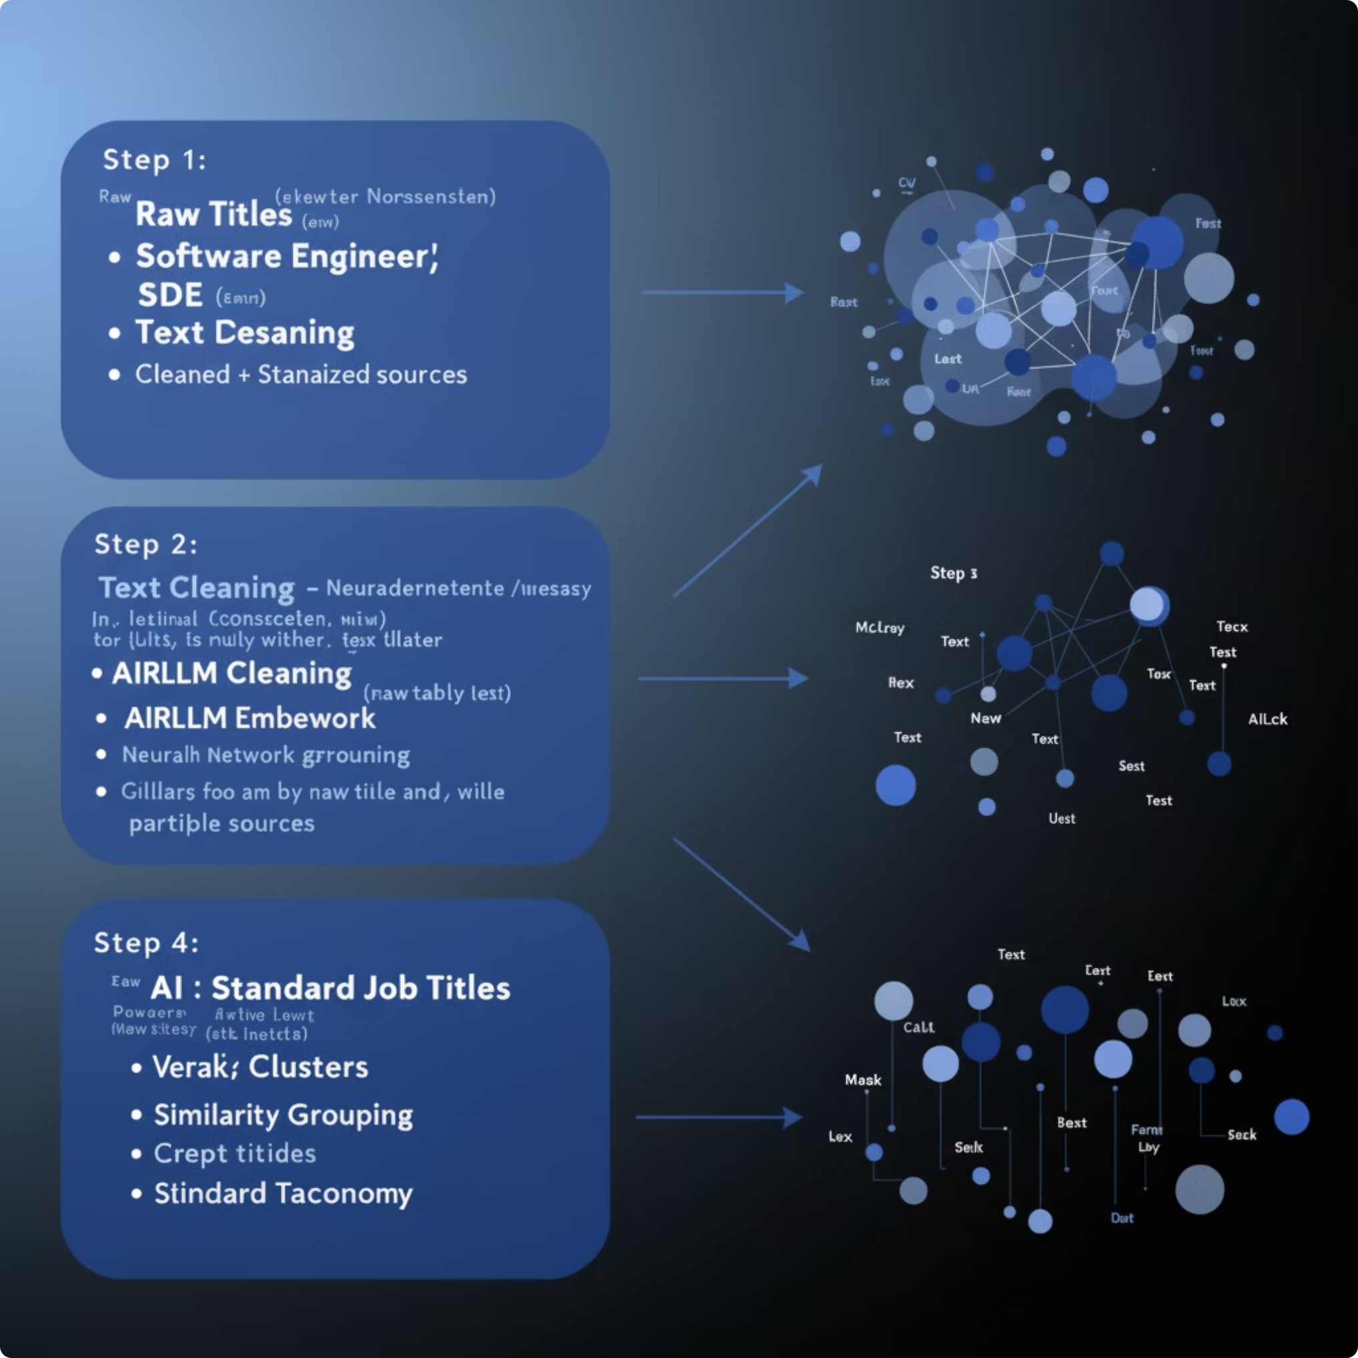





AI-Powered Job Title Normalization
Raw Job Titles
Inconsistent input data from multiple sources
Text Cleaning
Remove noise and standardize format
AIRLLM Embedding
Generate semantic representations
Similarity Grouping
Cluster related job titles together
Standard Job Titles
Clean, consistent output taxonomy

Slide 14

Why AIRLLM?
Lightweight
Fast Performance
Fully Offline
Optimized LLM inference with minimal memory footprint. Runs efficiently on standard hardware without requiring expensive GPU infrastructure. Reduces computational overhead by up to 60% compared to traditional LLM approaches, making it cost-effective and accessible for organizations of all sizes.
Faster than full LLM pipelines for real-world tasks. Delivers sub-second response times for job title normalization and semantic processing. Enables real-time data quality validation at scale without any performance degradation, even with millions of records.
Pretrained LLM runs locally with no cloud API dependency. Complete data sovereignty and zero latency. No reliance on external services or internet connectivity for core processing. Eliminates vendor lock-in risks and ensures complete independence.
Enterprise-Friendly: We don't send data outside. Everything runs locally, ensuring cost-effectiveness, complete data security, regulatory compliance, protection against API rate limits, and independence from third-party vendors. Your data stays yours.

Slide 15
Quality Assurance & Scoring
Errors Detected
Our Multi-Layer Validation Process
Typos and spelling mistakes: Identifies and corrects common misspellings and grammatical errors in job titles
01
02
Standardization & Parsing
Rule-Based Validation
Duplicate records: Detects and flags identical or near-duplicate entries across datasets
Initial processing to standardize formats, correct simple errors, and parse raw data into structured fields.
Application of predefined business rules and regex patterns for data type, range, and format validation.
Inconsistent formatting: Standardizes capitalization, spacing, and special characters
Phone number validation: Uses Twilio to verify active and correctly formatted phone numbers
03
04
Temporary/disposable email detection: Blocks common disposable email providers (e.g., mailinator.com, 10minutemail.com)
AI-Powered Anomaly Detection
Real-Time Verification
Leverages machine learning to identify complex inconsistencies, outliers, and potential fraud beyond simple rules.
Integration with external APIs (e.g., Twilio for phone, email verification services) for live data accuracy checks.
Data completeness checks: Flags missing required fields essential for record integrity
Outlier detection: Identifies unusual patterns or anomalies that indicate potential data issues
05
Continuous Monitoring
Invalid email formats: Validates email structure and domain authenticity using advanced verification
Ongoing assessment and feedback loop to adapt validation rules and improve data quality over time.

Slide 16




Interactive Data Quality Bot
Empowering users with direct access to data insights, our new conversational AI tool simplifies complex data querying and quality checks, built directly on top of the AIRLLM engine.
Retrieve Specifics
Pinpoint Inconsistencies
Query Analyzed Data
Instantly fetch exact entries or details from your normalized datasets using natural language commands.
Automatically identify and isolate any remaining inconsistent or anomalous data points for further review.
Gain quick insights by querying overall analyzed data, trend summaries, and quality metrics with simple questions.

Slide 17





Results & What Makes Us Unique
Proven Results
Significantly reduced data errors and improved consistency across all datasets
Offline AI Innovation
Unique AIRLLM implementation ensures data never leaves your infrastructure
Multi-Layer Validation
Comprehensive quality checks at every stage of the pipeline
Unique Ideas
Phone numbers are validated using Twilio to ensure they are active and correctly formatted, while email addresses are verified by allowing trusted providers such as Gmail, Yahoo, and Outlook and blocking temporary or disposable email services providers like mailinator.com, 10minutemail.com, tempmail.com, etc. to maintain data authenticity.

Slide 18



Future Enhancements
DQ Dashboard
Self-Learning Models
Visual insights and monitoring
Real-Time APIs
Continuous improvement from feedback
Instant data quality validation
VETRI DQX delivers intelligent, scalable, and secure data quality
Thank You

